Slide 1

Experiment 7: Watering Plant System
Navarro, Rod Geryk C.
CPE160P - 4– A1

Slide 2
OBJECTIVES
To be able to demonstrate how an automatic watering plant system works.
2. To be able to apply embedded system in maintaining the moisture in the soil of the plant.
3. To be able to demonstrate how the servo motor or stepper motor will function to water the plant.
4. To be able to apply what you have learned in Microprocessor and Logic Cuircuits and Switching Theory.
5. To be able to apply embedded system in a simple handshaking using Arduino Kit.

Slide 3
MATERIALS
Arduino Kit
Moisture Sensor
Servo Motor
Straw
Popsicle Stick
LCD 16x2
Laptop

Slide 4
PROCEDURE
Create a working Watering Planting circuit using Arduino.
To demonstrate the usage of moisture sensor, and servo motor.
Debug the code

Slide 5
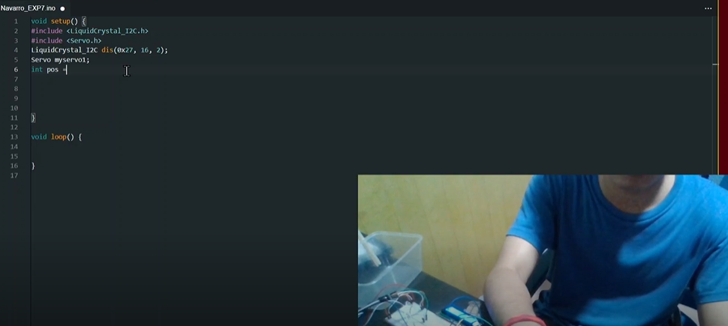
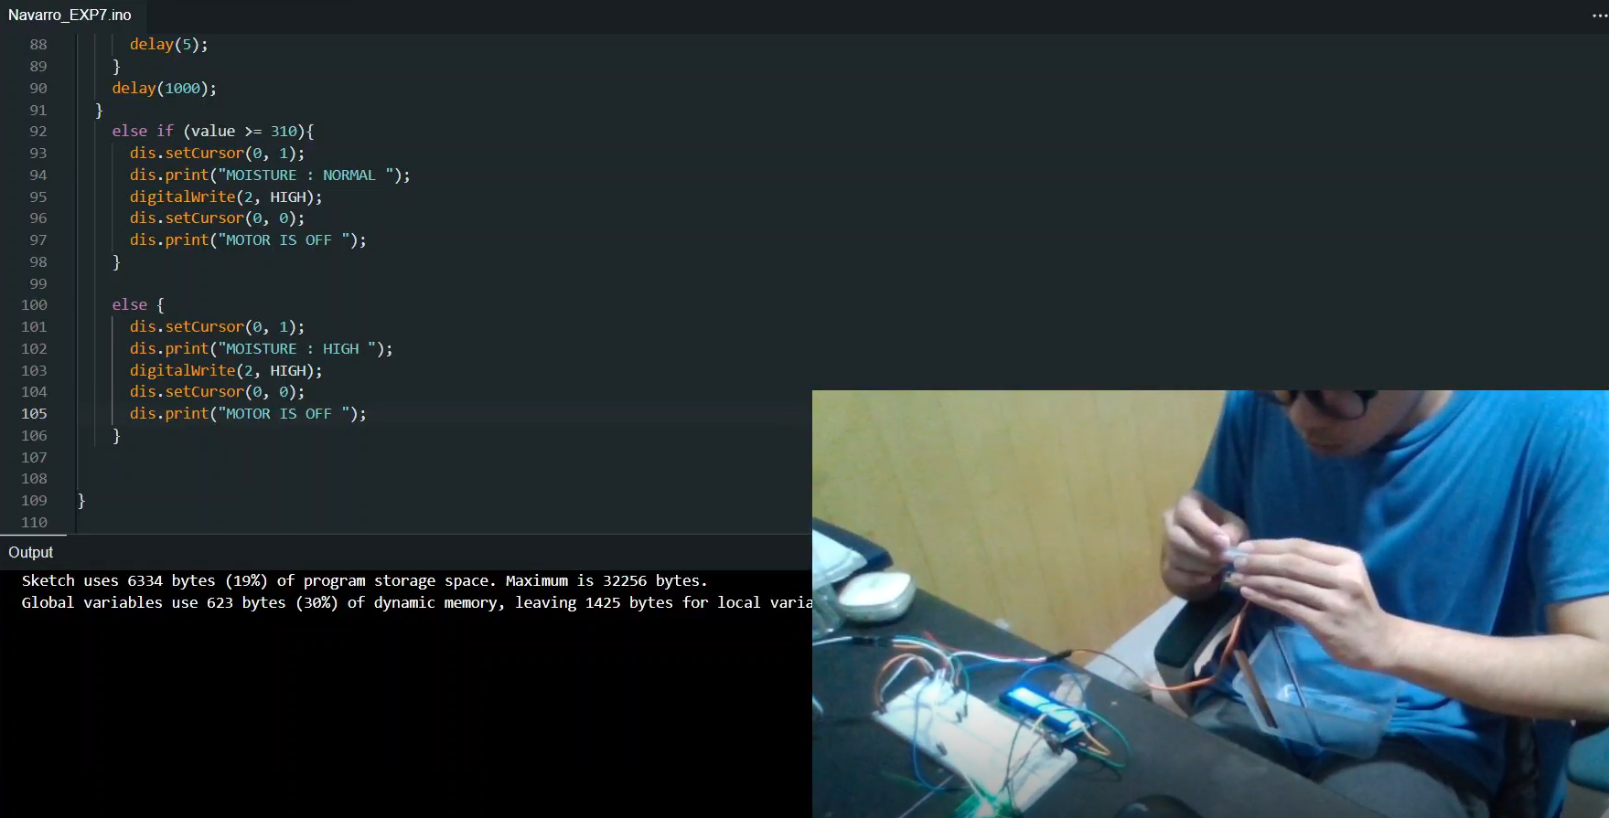
PROCEDURE

Slide 6
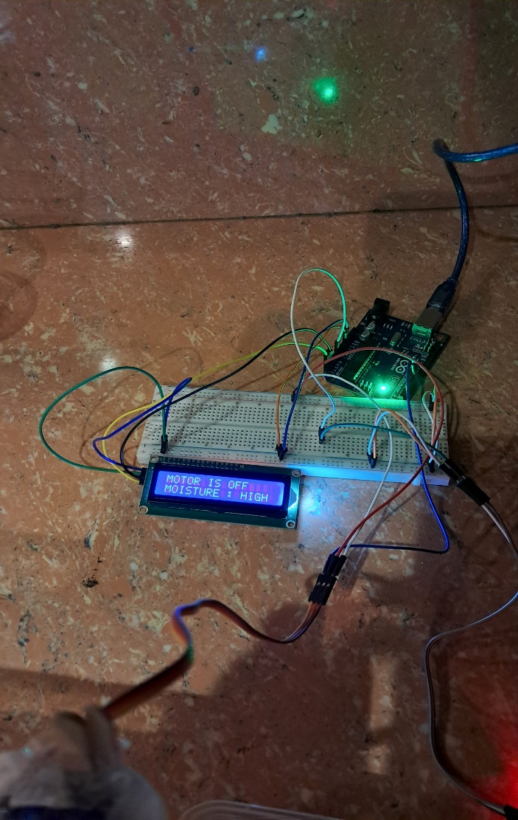
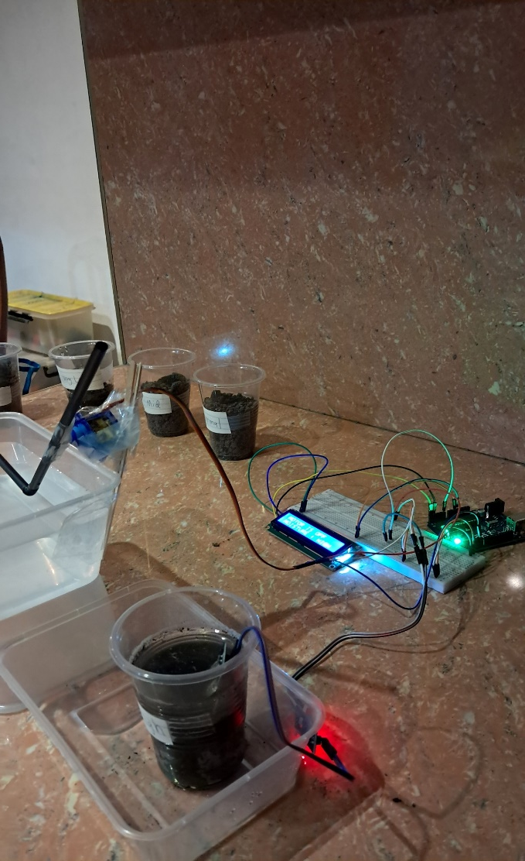
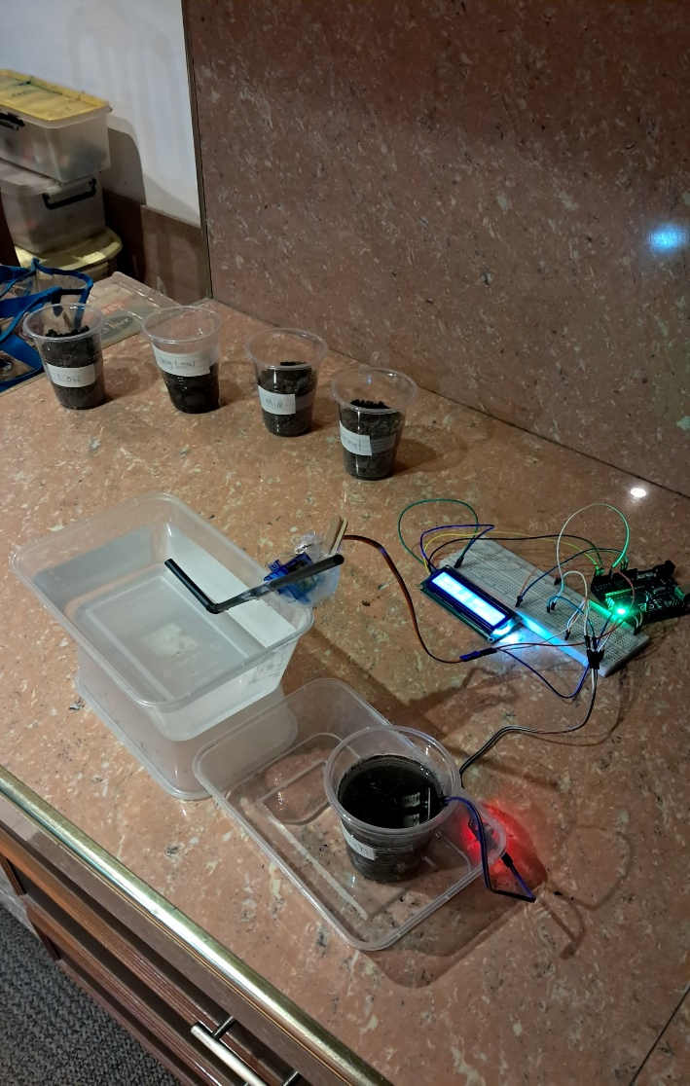
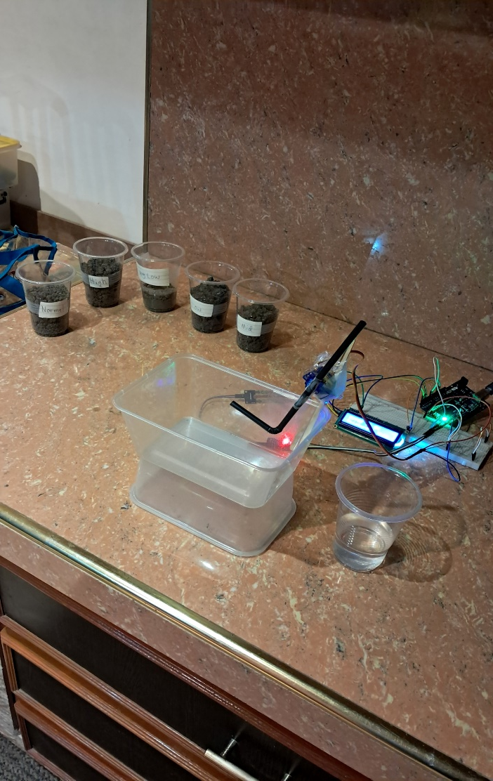
Final Output

Slide 7
THANK YOU!

